Slide 1
ADDENDUM PRENATAL CHORNOBYL RADIATION EXPOSURES
My story
W. Wertelecki, M.D.
WELCOME to the ADDENDUM
Part 3 How OMNI-Net was Established
Please continue or Return to the Video
http://ceo.medword.net/?overviews=chernobyl-dogma-vs-facts
Addendum to Chornobyl Radiation and Pregnancies OMNI-Net MedWord LLC. © All Rights Reserved http://ceo.medword.net/contents/

Slide 2
ADDENDUM PRENATAL CHORNOBYL RADIATION EXPOSURES
CRITICAL STEPS TOWARD OMNI-Net
Addendum to Chornobyl Radiation and Pregnancies OMNI-Net MedWord LLC. © All Rights Reserved http://ceo.medword.net/contents/

Slide 3
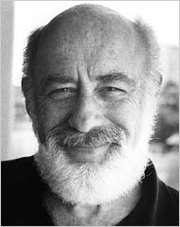
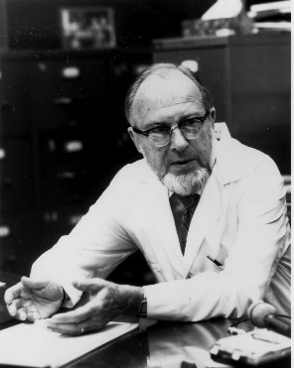
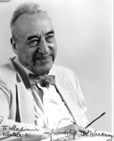
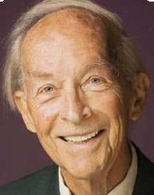
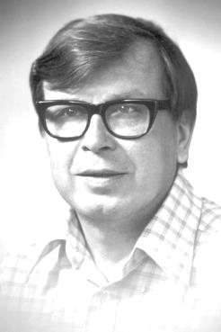
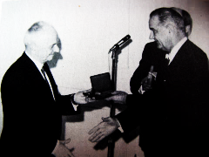
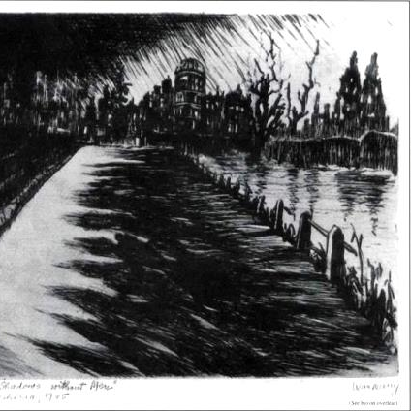
ADDENDUM PRENATAL CHORNOBYL RADIATION EXPOSURES
CRITICAL STEPS TOWARD OMNI-Net Gathering Ideas and Perceptions (1986 – Ongoing)
James Neel
Michael Kasha
John W Gofman
Josef Warkany
Carleton Gajdusek
Curiosity awakens
Knowledge sensitizes
Science analyzes
Philosophy seeks wisdom
Ethics seeks “ULTIMATE END” PREVENTION
Theodosius Dobzhansky President L. Johnson National Medal of Science
(continued)
Addendum to Chornobyl Radiation and Pregnancies OMNI-Net MedWord LLC. © All Rights Reserved http://ceo.medword.net/contents/

Slide 4
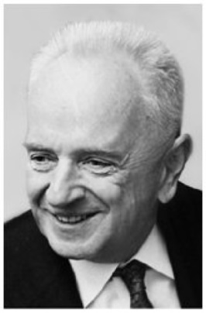
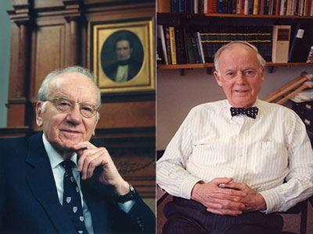
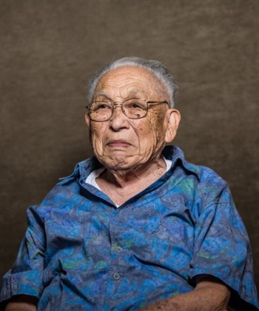
ADDENDUM PRENATAL CHORNOBYL RADIATION EXPOSURES
1986 - 1991
James Neel
Michael Kasha
T Dobzhansky
John W Gofman
Josef Warkany
Carleton Gajdusek
https://en.wikipedia.org/wiki/John_Gofman
https://en.wikipedia.org/wiki/James_V._Neel
https://en.wikipedia.org/wiki/Josef_Warkany
https://en.wikipedia.org/wiki/Daniel_Carleton_Gajdusek
https://en.wikipedia.org/wiki/Michael_Kasha
https://en.wikipedia.org/wiki/Theodosius_Dobzhansky
http://www.aasc.ucla.edu/cab/200706130005.html
https://en.wikipedia.org/wiki/Barton_Childs
https://en.wikipedia.org/wiki/Victor_A._McKusick
…
Victor McKusick Barton Childs
James Yamasaki
Addendum to Chornobyl Radiation and Pregnancies OMNI-Net MedWord LLC. © All Rights Reserved http://ceo.medword.net/contents/

Slide 5
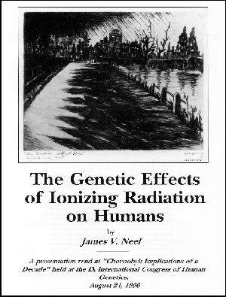
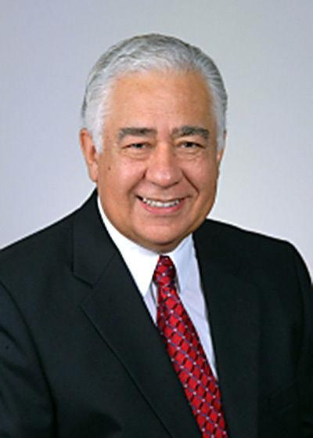
ADDENDUM PRENATAL CHORNOBYL RADIATION EXPOSURES
WIDER STEPS (1991-2000)
INTERNATIONAL CONGRESS of HUMAN GENETICS Round Table
CHERNOBYL GENETIC EFFECTS August 24st, 1991
C. Salinas
Some of the Key Contributors Drs. G. Laziuk and I. Baryliak representing Belarus (1) and Ukraine respectively (2). Dr. L. Anspaugh spoke about ongoing IAEA investigations of environmental consequences (3) Dr. J. Neel elaborated upon Genetic effects (4) Mr. G. Widney spoke how to deal with the Legacy of Chernobyl (5).
(1) https://www.ncbi.nlm.nih.gov/pubmed/8001808 (2) http://www.ibis-birthdefects.org/start/2008_summit.htm (3) https://www.ncbi.nlm.nih.gov/pubmed/3201240 (4a) https://www.pnas.org/content/95/10/5432
(4b) https://link.springer.com/article/10.1007%2Fs10739-014-9385-0 (5) https://www.thelancet.com/journals/lancet/article/PIIS0140-6736(05)65628-0/fulltext
Addendum to Chornobyl Radiation and Pregnancies OMNI-Net MedWord LLC. © All Rights Reserved http://ceo.medword.net/contents/

Slide 6
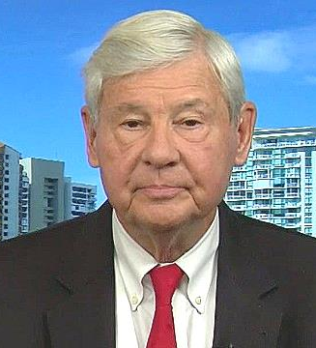
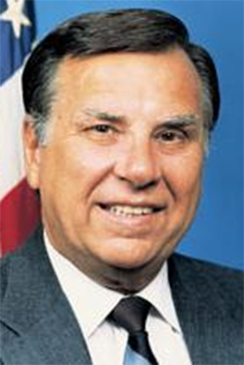
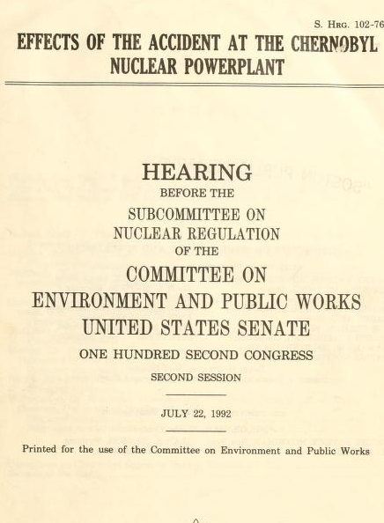
ADDENDUM PRENATAL CHORNOBYL RADIATION EXPOSURES
CONTRIBUTORS
1992
Senator Daniel Robert Graham
Senator
Joseph Isadore Lieberman
Representative Herbert Leon Callahan
BRIEF EDITED EXTRACT http://ukraineomni.org/wp-content/uploads/2019/07/сongress.pdf FULL REPORT https://archive.org/download/effectsofacciden00unit/effectsofacciden00unit.pdf
Addendum to Chornobyl Radiation and Pregnancies OMNI-Net MedWord LLC. © All Rights Reserved http://ceo.medword.net/contents/

Slide 7
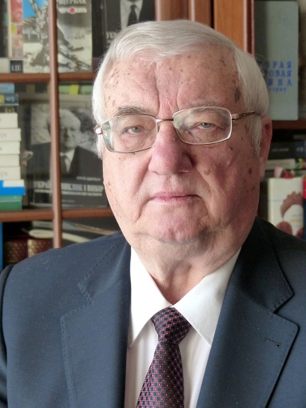
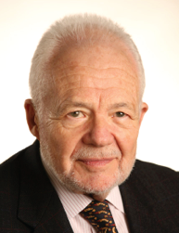
ADDENDUM PRENATAL CHORNOBYL RADIATION EXPOSURES
BIRTH DEFECTS PREVENTION ACT
1997-1998
Dr. Ihor Maznyk National Cancer Institute
Dr. Yuriy Shcherbak. Ukraine Ambassador
Dr. Michael Katz March of Dimes Birth Defects Found.
Addendum to Chornobyl Radiation and Pregnancies OMNI-Net MedWord LLC. © All Rights Reserved http://ceo.medword.net/contents/

Slide 8
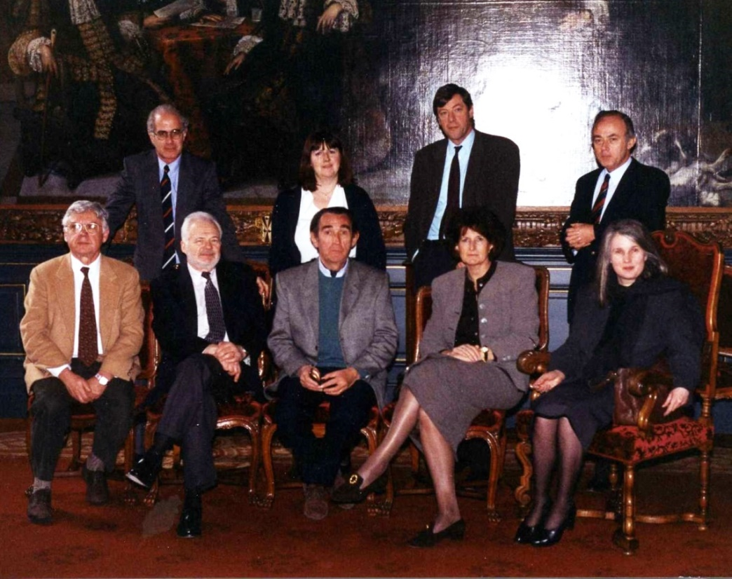
ADDENDUM PRENATAL CHORNOBYL RADIATION EXPOSURES
EARLY STEPS (1986-2008) Defining a Global and Ukrainian Alliances for the Prevention of Birth Defects
1998
Ministry of Health, Kyiv, Ukraine
D
B
D
E
A
D
A
B
C
F
G
H
C
B
International Court of Justice, The Hague, Holland
Partial list of participating international experts: (A) Dr. Jennifer House, President of the March of Dimes; (B) Dr. Michael Katz, VP for Science, March of Dimes and 1st President of the World Alliance for the Prevention of Birth Defects (WAPBD); (C) Dr. W. Wertelecki, prospective Director of the OMNI-Net in Ukraine and WAPBD Secretary-Treasurer ; (D) Mr. Y. Poortman, VP of the WAPBD and leader of European Alliances of Parental Support Groups; (E) Dr. John Harris, Director, California Birth Defects Monitoring Program; (F) L. Edmonds, Centers for Disease Control; (G) Dr. V. Zamostian, Associate Dean, Kyiv Mohyla Academy University; (F) Dr. Ihor Baryliak, Teratologist, Institute of Social Hygiene; Lower row – Delegation of Ukrainian Medical Geneticists.

Slide 9
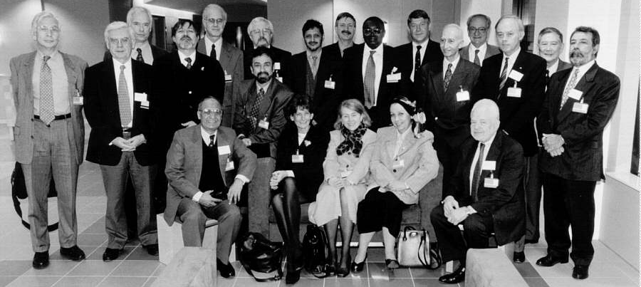
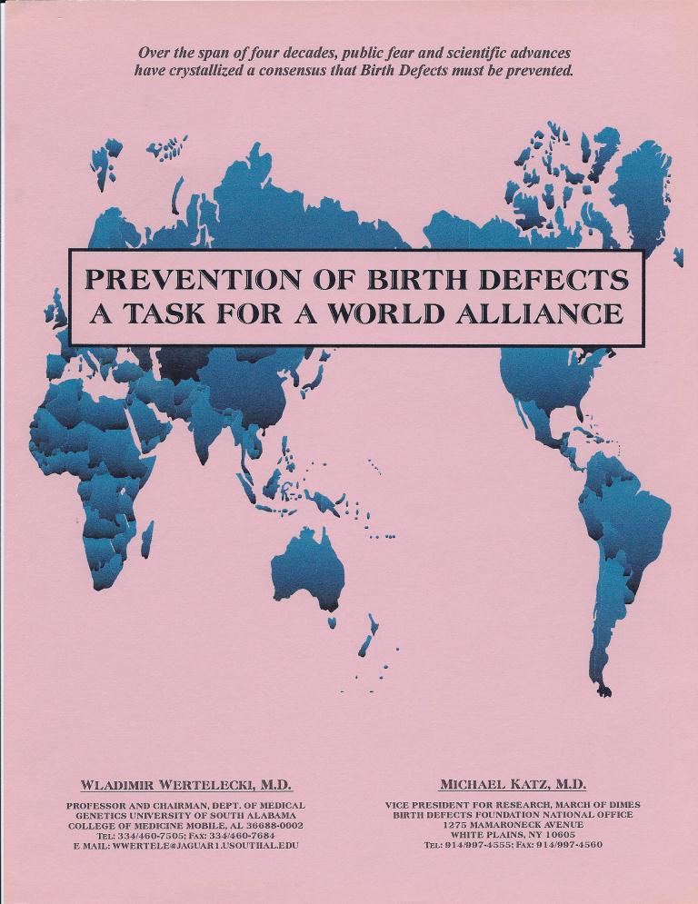
ADDENDUM PRENATAL CHORNOBYL RADIATION EXPOSURES
A World Alliance for the Prevention of Birth Defects
1991
2001 International Congress of Human Genetics Experts from 18 Nations
C
D
B
A
B
“Prevention of Birth Defects” by W. Wertelecki and M. Katz was published in English, Spanish, Russian, Ukrainian, Japanese, Chinese … Jpn. J. Hum. Genet 40:295, 1995; Medico Interamericano 5:185 1995 and a separate report concerning the Hague
Zhonghua Min Guo Xiao Er Ke Yi Xue Hui Za Zhi
https://apps.who.int/iris/handle/10665/66501
Addendum to Chornobyl Radiation and Pregnancies OMNI-Net MedWord LLC. © All Rights Reserved http://ceo.medword.net/contents/

Slide 10
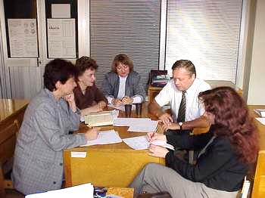
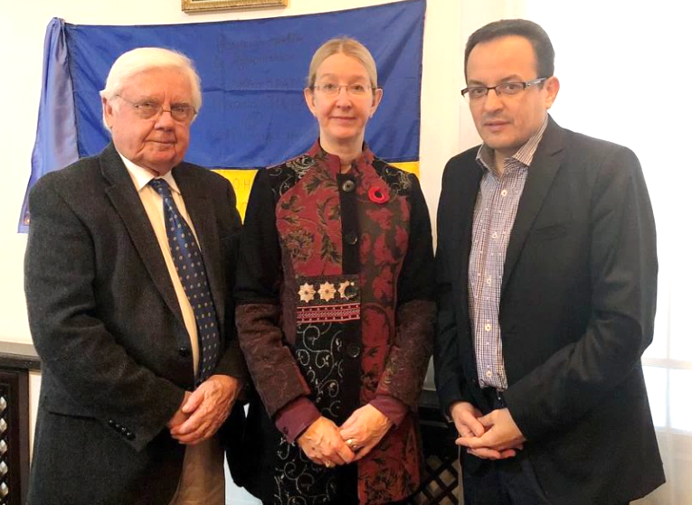
OMNI-NET REALIZATION IN UKRAINE
I. Baryliak with Core OMNI-Net Team
2018
1998
W. W. – Minister of Health and Sponsor of NTD Prevention Law
Companion Website Reports
Early Predictors of FASD in Ukraine U01AA014835-14 |
https://cifasd.org/
Addendum to Chornobyl Radiation and Pregnancies OMNI-Net MedWord LLC. © All Rights Reserved http://ceo.medword.net/contents/

Slide 11
ADDENDUM PRENATAL CHORNOBYL RADIATION EXPOSURES
START of the PROGRAM in UKRAINE (1999)
https://www.ncbi.nlm.nih.gov/pubmed/16682756
2006
Addendum to Chornobyl Radiation and Pregnancies OMNI-Net MedWord LLC. © All Rights Reserved http://ceo.medword.net/contents/

Slide 12
ADDENDUM PRENATAL CHORNOBYL RADIATION EXPOSURES
My story
W. Wertelecki, M.D.
Other Contents
Active links cited in the Video Main Report – Data – Figures
Addendum to Chornobyl Radiation and Pregnancies OMNI-Net MedWord LLC. © All Rights Reserved http://ceo.medword.net/contents/

Slide 13
ADDENDUM PRENATAL CHORNOBYL RADIATION EXPOSURE
END of the ADDENDUM
THANK YOU FOR YOUR INTEREST and ATTENTION! To return to Start of the Story please click
http://ceo.medword.net/?overviews=chernobyl-dogma-vs-facts
To view other reports please click Clinical Eye Openers (CEO) - http://ceo.medword.net/ Birth Defects Information System (IBIS) - http://ibis-birthdefects.org/ Pandora Word Box - http://www.pandorawordbox.com/
Please note our webinar series – “Elements of Clinical Teratology” http://ceo.medword.net/webinars/
Addendum to Chornobyl Radiation and Pregnancies OMNI-Net MedWord LLC. © All Rights Reserved http://ceo.medword.net/contents/

